Slide 1
Can long-term memory help a small model build better websites?
Group meeting · WebGen-Bench
Text lessons vs code examples
Qiaopan Ma · Supervisor: Qian Liu · 16 October 2026
Notes:
Good morning, everyone. I am Qiaopan. My question: can long-term memory help a small model build better websites, and should that memory be text or code?

Slide 2
A 7B model builds 101 websites, one after another
The task and the question
Benchmark
Long-term memory
WebGen-Bench: 101 website requests from 20 areas. A GUI agent clicks through each site and checks the features.
After each task, the system writes down what went wrong. Later tasks can reuse it.
Question: does the model get better as it gains experience?
Notes:
A 7B model builds 101 websites, one after another, on WebGen-Bench. A GUI agent tests each site. With long-term memory, the system writes down what went wrong after each task, and later tasks reuse it. Does the model get better with experience?

Slide 3



The official pipeline, and what Long Memory adds
The big picture
WebGen-Bench baseline (No Memory)
Website request
Generator
Testers
Score
text from the user
Bolt agent + WebGen-LM-7B
WebVoyager + Qwen2.5-VL-32B; screenshot grader
pass / partial / fail
Before the next task: add a checklist and code examples
After each task: reflect on the test, find code errors, save short fixes
Memory bank
Qwen2.5-VL-72B + bge-m3
Same generator, same tester, same rules. Long Memory (blue) only changes the text the generator reads.
Notes:
The top row is the official pipeline: request, generator, testers, score. Our memory, in blue, reflects after each task and adds a checklist and code examples before the next one. Everything else stays the same.

Slide 4
Official rules, and our baseline matches the paper
Setup
# | Step | Agent / tool | Model (LLM)
1 | Build website | Bolt agent (coding) | WebGen-LM-7B, one try, no repair
2 | Test features | WebVoyager (GUI agent) | Qwen2.5-VL-32B
3 | Grade appearance | Screenshot grader (one call) | Qwen2.5-VL-32B (paper: GPT-4o)
4 | Write and pick memory | Our Long Memory module | Qwen2.5-VL-72B-AWQ + bge-m3 embedding
Score = (pass + 0.5 × partial) / checks · No Memory baseline 28.5% (paper: 28.4%)
Check results: pass = the feature works; partial = it works only in part (counts 0.5); fail = 0. Accuracy is summed over all 647 checks.
Notes:
All models run on our own cluster. The generator gets one try with no repair. Accuracy counts pass as one and partial as half. Our No Memory baseline gives 28.5 percent; the paper reports 28.4, so the pipeline is faithful.

Slide 5
A small model trained for this tool, on two H200 GPUs
Models and compute
WebGen-LM-7B (the generator)
Hardware: 2 × NVIDIA H200 (141 GB each)
• Built by the WebGen-Bench authors
• Base: Qwen2.5-Coder-7B-Instruct
• Fine-tuning only (SFT), no RL
• Data: DeepSeek-V3 built sites in Bolt for 2,000 requests; kept the 600 best (look ≥ 3/5)
• So it already knows Bolt’s output format
• Paper baseline: 28.4%
• GPU 0: 32B tester (83 GB) + 7B generator (26 GB)
• GPU 1: 72B memory model (113 GB) + bge-m3 (2 GB)
• All self-hosted with vLLM; no paid API
• Two tasks in parallel, about 12 min each
• About 470 GPU-hours since 5 Oct
• All runs finished in about 2 weeks
Notes:
Before the results, a word on the models and compute. The generator is WebGen-LM-7B. It is not a general Qwen model: the WebGen-Bench authors took Qwen2.5-Coder-7B-Instruct and fine-tuned it on about 600 website-building trajectories that DeepSeek-V3 produced inside Bolt, keeping only good-looking sites. So it already speaks Bolt's format, which makes it a fair small baseline. Everything runs on two H200 GPUs on the school cluster. The first GPU holds the 32B tester and the 7B generator; the second holds the 72B memory model and the embedding model. No paid API is used. We run two tasks in parallel, about twelve minutes each, and so far we have used about 470 GPU-hours.

Slide 6
11 full runs × 101 tasks: about 1,100 websites and 7,000 checks
Experiment scale
Done (in the thesis)
Still running (two lanes in parallel)
No Memory in 3 task orders (original, seed 11, seed 29)
Text memory, code memory (whole-file), checklist only: original order
Code memory, whole-file and fragments, in 2 shuffled orders
Fragments in the original order: 35.2% (done 16 Oct)
Seed 47: about 60/101 on 16 Oct
Seed 47 and interleaved orders: 17 Oct
Fixed code from task 1, no memory: 17–18 Oct
Notes:
This slide shows the size of the study. Each run builds all 101 websites. We have eleven full runs: about one thousand one hundred websites and seven thousand checks. No Memory was run in three task orders, to measure how much the baseline itself varies. The fragment version in the original order finished this morning. Seed 47 is about sixty percent done; the interleaved order and the fixed-code control follow.

Slide 7
Text lessons helped early, then fell below the baseline
First attempt: text lessons
Tasks | No Memory | Text memory
Tasks 1–30 | 26.0% | 39.3%
Tasks 61–101 | 24.8% | 22.9%
Over time, more and more vague advice filled the prompt, such as "make sure the form works". The small model could not act on it.
Each number is the accuracy on that group of tasks, in execution order. Tasks 31–60 are left out to show the start and the end clearly.
Notes:
Our first attempt, text memory, used text lessons. They helped on the first 30 tasks, but by the end text memory fell below No Memory, because vague advice filled the prompt and the small model could not act on it.

Slide 8


One missing package turns the whole site into an error page
What the tester sees · task 000006, a solar dashboard
No Memory: imports vue-chartjs, which is not installed → score 0
Code memory (fragments): three working views → score 1.0
Notes:
Here is what failure actually looks like. Same task, a solar dashboard. Without memory, the model imports a chart library that is not installed. The page shows only this error, so every test fails and the task scores zero. This is the most common way the 7B model gets zero. With the final memory, the prompt carried a short code example from an earlier site that worked; the model built all three views and every test passed. The numbered boxes are drawn by the tester to name what it can click.

Slide 9
The small model follows code, not text
Key finding
1 / 3
7 / 9
blank-page sites fixed by a text tip
fixed by a 10-line code example
Blank page: the site imports a package that is not installed (for example vue-router), so nothing is shown. Test: generate only, same prompts, check the code.
Notes:
This led to our key finding. Many sites were blank because they used a package that was not installed. A text tip fixed one in three. A ten-line code example fixed seven in nine. The small model follows code, not text.

Slide 10
Two parts: a checklist and a code pool
Method · code memory
1. Requirement checklist
2. Code pool
The memory model splits the request into a list. Each lesson sits under the item it belongs to. The request always comes first.
When a code error appears in 2 tasks, take a short fix from our own earlier site that worked. At most 15 lines, checked by a compiler.
Example: import { ref } from 'vue' · const bookingId = ref('')
Notes:
So whole-file code memory has two parts. A checklist that splits the request, and a code pool: when an error appears in two tasks, we take a short working fragment from our own earlier sites, checked by a compiler.

Slide 11
Text memory → code memory (whole-file) → code memory (fragments)
Three memory designs
Design | What memory gives the model | Why we moved on | Result (101 tasks)
Text memory | Checklist + text lessons | Vague text piles up; the 7B model ignores it | 30.9%; below NM after task 30
Code memory (whole-file) | Checklist + code examples, some whole files | Whole-file examples caused blank sites in new orders | 40.0%, +11.5
Code memory (fragments) | Final method: only checked fragments; chosen for robustness across orders, not top score | Original order: lower than whole-file (vue-router came back) | 35.2%, +7.1; seed 11 +7.4; seed 29 +5.5
Ablation: checklist only | Checklist, memory turned off | — | 31.8% (+3.4, CI includes 0)
NM = No Memory (28.5%). Repository labels: v4, v7, v9.1.
Notes:
We tried many versions, but they fall into three families, and from now on I only use these three names. Text memory gives the model lessons written as text; its last version adds a checklist. The text piles up and the small model ignores it: 30.9 percent. Code memory keeps the checklist and adds short code examples from our own working sites: this is the big jump, to 40 percent. The final version shows only checked fragments, never a whole file. It reaches 35.2 percent in the original order, lower than the whole-file version, but it removed the blank-site failure in the shuffled orders. We chose it for robustness across orders, not for the top score. The last row is an ablation: the checklist alone, with memory turned off, helps only a little.

Slide 12
Accuracy rises from 28.5% to 35–40%
Main result · 101 tasks, one run
No Memory
Code memory (whole-file)
28.5%
40.0%
30 zero-score tasks
13 zero-score tasks
Whole-file: +11.5 points (95% CI 6.0 to 16.9), wins 54 / losses 24. Fragments (final method): 35.2%, +7.1 (0.9 to 13.1), 20 zero-score tasks.
Zero-score task: every check fails, usually a blank page. 95% CI: the likely range of the gain, from resampling tasks; it does not include 0.
Notes:
The main result. Without memory: 28.5 percent and 30 zero-score tasks. With whole-file code memory: 40 percent and 13. Paired by task, the gain is 11.5 points, and the 95 percent confidence interval, 6 to 16.9, does not include zero. The final method with fragments reaches 35.2 percent, a gain of 7.1 points with interval 0.9 to 13.1, lower than whole-file in this order because vue-router imports came back.

Slide 13
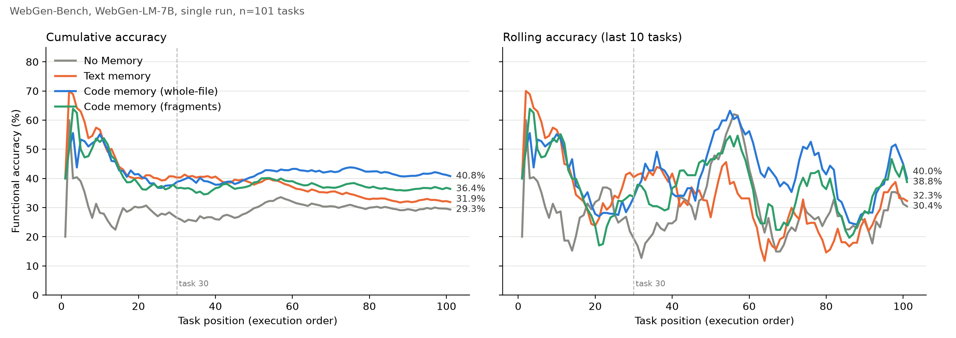
Only the code-pool version keeps its lead
Learning curve · 101 tasks, execution order
Left: cumulative = average of all tasks so far. Right: rolling = average of the last 10 tasks, so it shows short-term ups and downs. Dotted line: task 30.
Notes:
This is the learning curve, in execution order. Text memory, in orange, starts high and then falls below No Memory. Both code memories, blue for whole-file and green for fragments, stay above No Memory to the end. So the gain is not only an early boost.

Slide 14
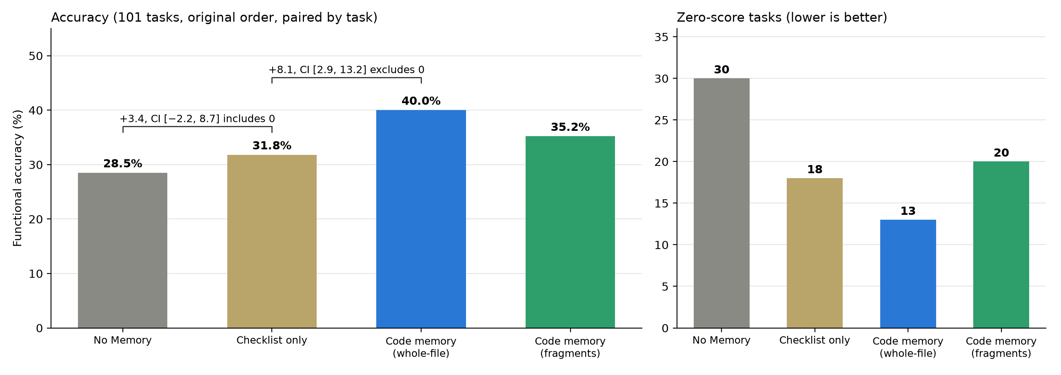
Memory, not the checklist, drives the gain
Ablation study · checklist vs. memory
Zero-score tasks: sites where every check fails.
Takeaways
Checklist alone: +3.4 points, CI includes 0; mainly fewer blank sites.
Memory on top of the checklist: +8.1 points (95% CI 2.9 to 13.2).
So most of the gain comes from memory, not from splitting the request.
Notes:
The ablation adds one part at a time. The checklist alone adds 3.4 points, and its confidence interval includes zero. Adding memory on top adds 8.1 points, and that interval excludes zero. So most of the gain comes from memory.

Slide 15
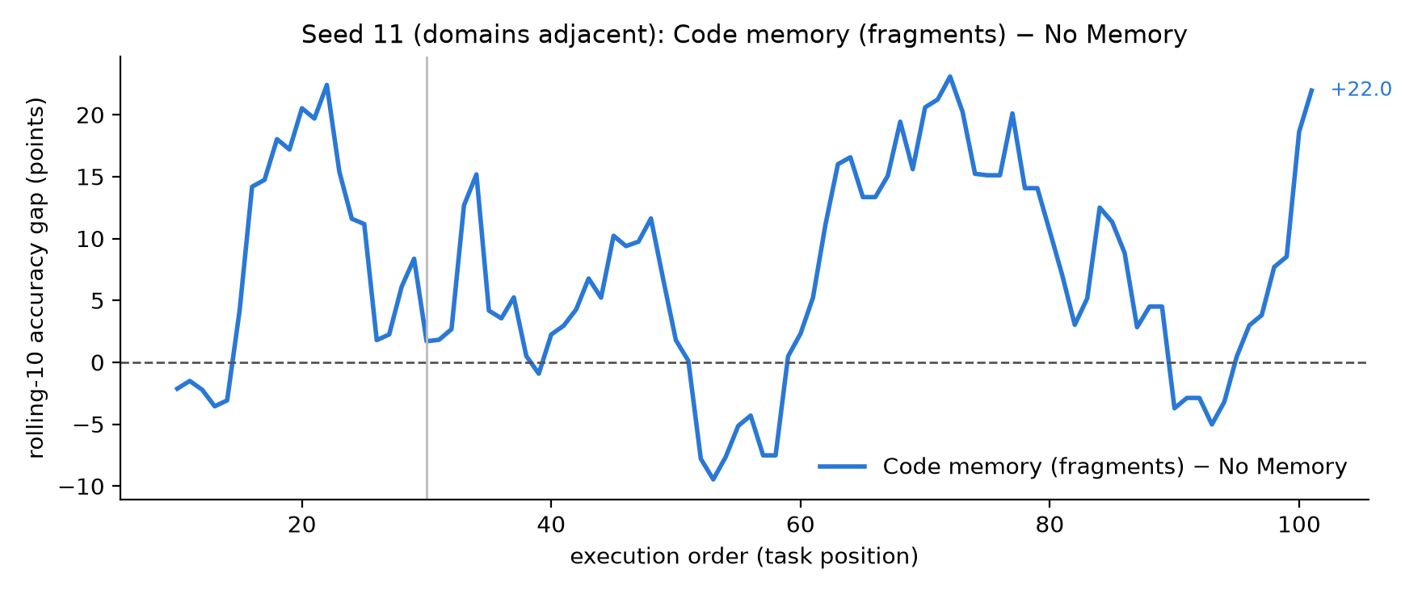
Fragments removed blank scaffolds in shuffled orders
Task order · shuffled runs
Task order | Version | Code example in memory | Gain vs No Memory (95% CI) | Blank scaffolds
Seed 11 (blocks) | Code memory (whole-file) | Whole App.vue file | +4.4 (−1.9 to 10.6) | 19
Seed 11 (blocks) | Code memory (fragments) | Checked fragment | +7.4 (1.6 to 13.1) | 0
Seed 29 (random) | Code memory (whole-file) | Whole App.vue file | +4.5 (−2.2 to 11.3) | 16
Seed 29 (random) | Code memory (fragments) | Checked fragment | +5.5 (−0.5 to 11.6) | 0
What it means
With whole-file examples, the model copied a whole file as a finished answer and returned the empty starter project.
With fragments: zero blank sites in both orders.
No Memory is stable (27.9–28.6%), so the change is on the memory side.
Notes:
With memory, the task order matters, because each task can only use what came before it. We tried two shuffled orders. With whole-file code memory the gain dropped to about four and a half points. The reason: one code example was a whole file, and the model copied it as a finished answer, returning the empty starter project. In the fragment version every example is a short checked fragment. Blank sites go to zero, and the gain is 7.4 points on seed 11, with an interval that excludes zero, and 5.5 on seed 29. In the original order, though, fragments stopped the missing vue-router package less reliably, so neither form wins in every order.

Slide 16
What we still need to check
Limits and next steps
Limits
Next steps
One run per task order (the paper also uses one run)
Gain is in features, not in look (3.25 vs 3.22)
One model and one tool (Bolt + Vue)
Method tuned on the same 101 tasks; in the original order fragments (35.2%) trail whole-file (40.0%)
Seed 47 and interleaved orders: about 17–18 Oct
Fixed code prefix: after seed 47
Thesis draft to supervisor: 19 Oct
Notes:
Some limits. Each order has one run, as in the original paper. The gain is in features, not in look. We used one model and one tool, and the method was developed on this benchmark. In the original order the fragment version trails the whole-file version. Next: seed 47 and the interleaved order, then the fixed-code control, and the thesis draft goes to my supervisor on Monday.

Slide 17
References
Lu et al., 2025. WebGen-Bench: Evaluating LLMs on generating interactive and functional websites from scratch. arXiv:2505.03733.
He et al., 2024. WebVoyager: Building an end-to-end web agent with large multimodal models. ACL.
StackBlitz Labs, 2024. bolt.diy: open-source AI coding agent. github.com/stackblitz-labs/bolt.diy.
Zhao et al., 2024. ExpeL: LLM agents are experiential learners. AAAI.
Ouyang et al., 2026. ReasoningBank: Scaling agent self-evolving with reasoning memory. ICLR. arXiv:2509.25140.
Chhikara et al., 2025. Mem0: Building production-ready AI agents with scalable long-term memory. arXiv:2504.19413.
Wang, Mao, Fried & Neubig, 2025. Agent Workflow Memory. ICML. arXiv:2409.07429.
Zheng et al., 2024. Synapse: Trajectory-as-exemplar prompting with memory. ICLR. arXiv:2306.07863.
Wang et al., 2023. Voyager: An open-ended embodied agent with large language models. arXiv:2305.16291.
Suzgun et al., 2026. Dynamic Cheatsheet: Test-time learning with adaptive memory. EACL. arXiv:2504.07952.
Zhang et al., 2026. Agentic Context Engineering: Evolving contexts for self-improving language models. ICLR. arXiv:2510.04618.
Dai et al., 2026. Metis: Bridging text and code memory for self-evolving agents. arXiv:2606.24151.
Kim et al., 2026. Memory Transfer Learning: How memories are transferred across domains in coding agents. arXiv:2604.14004.
Shi et al., 2023. LLMs can be easily distracted by irrelevant context. ICML.
Liu et al., 2024. Lost in the middle: How language models use long contexts. TACL 12.
Du et al., 2025. Context length alone hurts LLM performance despite perfect retrieval. Findings of EMNLP. arXiv:2510.05381.
Madaan et al., 2023. Self-Refine: Iterative refinement with self-feedback. NeurIPS.
Notes:
These are our main references.

Slide 18
For a small model, memory should give code, not advice
28.5% → 35–40% · most of the gain comes from memory
Thank you. Questions? · Code and data: github.com/qiaopan/WebGen-Bench
Notes:
To sum up: for a small model, memory should give code, not advice. Accuracy rises from 28.5 percent to between 35 and 40 percent, depending on the form of the code examples, and most of the gain comes from memory. Thank you.

